Slide 1

Understanding MSKU
In Merchandising and Ads (MAD)
Presented by
Gna Phetsarath - January 2022
21 September 2020

Slide 2

Agenda
01
MSKU at eBay
02
What Does Search Do?
03
Cassini and MSKU
04
MSKU Refresh
05
Original MSKU Algos
06
Using Aspects to Power the Algos
07
Aspect and Ad Rate Boosting
08
Road Map
09
Demo / Q&A
Thank You to Everyone Who Contributed
10
Appendix

Slide 3

MSKU
at eBay
Source

Slide 4
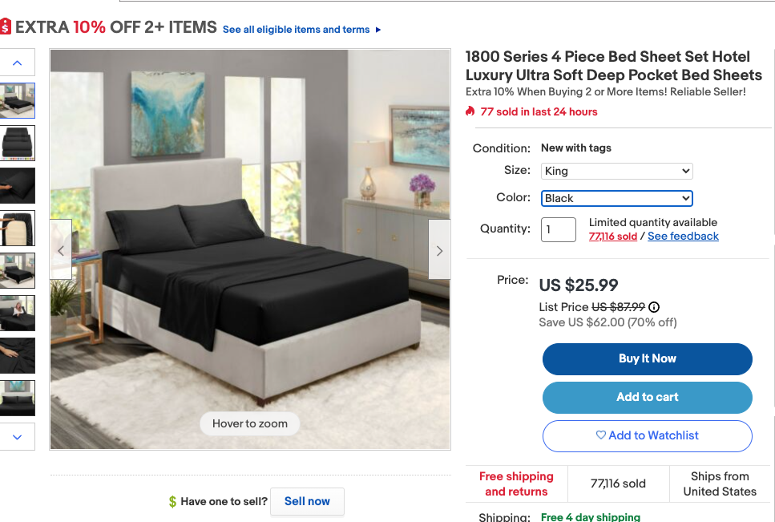
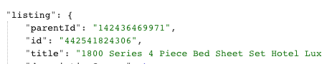
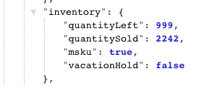
MSKU at eBay
https://www.ebay.com/itm/142436469971?var=442541824306
Multiple Stock-Keeping Unit
Short for Stock-Keeping Unit, SKU is a unique identifier (seller-specific) that refers to a specific stock item in a seller's inventory or product catalog. The SKU is often used to identify the product, product size or type, and the manufacturer. MSKU (Multi-SKU) means that instead of creating a number of separate listings for an item that has multiple options (variations of that item), the seller can create a single multi-quantity fixed price listing that includes all the variations the seller offers (e.g. a t-shirt might come in multiple colors and sizes; buyers can select which variation they want to purchase from the single listing). (wiki)
50%
30%
20%
16%
Categories with MSKU items
Non-MSKU Item in MSKU Category
MSKU Parent
MSKU Refresh
parentId, Inventory.msku=true
Splice.ListingUtils .isMsku
.isMskuWithParentId
Source

Slide 5

What Does Search Do?
Source

Slide 6

What Does
Search Do?
Cassini
Parent
A (100)
101
102
103
104
Search & MSKU
Searches for parent items and when it has variants, it will use a first round ranker to find the best variant. Only one variant is returned per parent.
What can we do in MAD?
Use LIME
Subquery with Custom Profile extended from PL Profile
Use KDUPs blender
Use Aspects for Recall Selection, Demotions and Filters
Parent
B (200)
201
202
203
204
Parent
C (300)
301
302
303
304
Item (400)
Search Results (before ML Ranking)
Item (400)
301
102
204
Source

Slide 7
Cassini
and
MSKU
“Maybe the Cassini (SBE Team) will be able to help us solve this problem?”

Slide 8
Cassini, LIME and MSKU
Cassini
KDUPS Blender
A blender to dedupe results by a specified field, in this case ParentID - JIRA TIcket: SBE-33468
Subquery with Custom Profile extended from PL Profile
Created a subquery which uses the KDUPS blender
Extend the PL Profile (20779) to use subquery by creating a new Cassini Profile (21770).
LIME
Already supported Cassini Profile ID or Profile Text - link
Set variants=Some(true) in Request
sort = Some(Sort.BestMatch(profileId = recallConfig.profileId, profileValue = if (recallConfig.profileId.isDefined) None else recallConfig.finalProfileString)
LIME
Request
Blender
LIME
SubQuery
Java
Query
Client
Profile
Cassini Request
Cassini
Search
Back End
(SBE)
Query
Result
Source

Slide 9

MSKU Refresh
Source

Slide 10
MSKU Refresh
VIP
Category
Service
View Item
Currently, does not call the the specialized variant, if the VIP lands on a variant item
For MSKU parent items, once the user selects all aspects a NORI call is made with
call_type=”ATF_MSKU_REFRESH”
selectedMskuAspects
Ads Platform
Merch Front End (MFE) - Calls HomeSplice to get recommendations for AlgoContext (seed item, user, etc.)
Nori - Calls MFE or Napkin for Response
Napkin - Cache of Nori Responses
HomeSplice
SpliceRequestBody is received by HomeSplice from MFE
Runs SpliceGraph for the GraphRunner for the appropriate Algorithm
Reads data from: Category Service, UMS, BullsEye, Top Aspect Job (and Others), Recall and Configs in CouchBase, Cassini, and TORA
Returns recommendations to MFE
ATF_MSKU_REFRESH
UMS
MFE
Nori
Napkin
BullsEye
Splice
Request
Body
MFE
Config
Top Aspects
Job
(CouchBase)
HomeSplice
CouchBase
Listings
or
Cards
Cassini
Retina
TORA

Slide 11
Original
MSKU Algorithms
“You have to start somewhere, I guess. Just get it working.” - Heard in eBay NYC Office in early 2021

Slide 12
Original MSKU Algorithms
Splice
Request
Body
SPLICE - Cassini Title Recall
includeVariant=true
profileId=20779
RequestBuilder sets variant=Some(includeVariant)
Add top Aspect Values based on UMS Aspect w/o Importance or Ranking
HomeSplice
SimilarMskuVariantBlueprints - SimplAMLv9PairwiseWebMskuAspectsV202108
Requests UMS based aspects for Seed and Recall
Recall
CassiniTitle(includeVariant=true)
ToraVaraintCoviewListings
Ultimately Bought
ImageSimCache
Filters
MskuVariantsPerParentId = 1
DisallowedAspects
FilteredByRules
Encoders
VariantSeedAspectsPayloadEncoder
PLX
MSKU Algo
Cassini
Title
Recall
UMS
Aspects
Keys
UMS Loading
Cache
Category
Service
UMS
LIME
Request
Aspect Values
As
Keywords
BullsEye
Aggregate
Recall
CouchBase
Rank
Enrich
Cassini
Listings
Response
Transformer
Filter
& Demotions
TORA
Source

Slide 13
Using Aspects
to Power
the MSKU Algos
“There are so many aspects from so many sources! What do we do?”

Slide 14
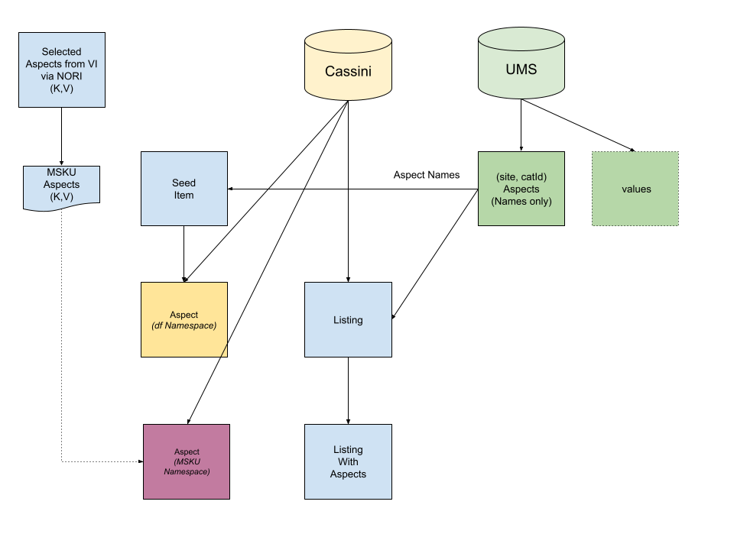
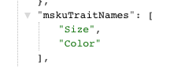
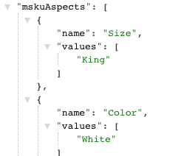
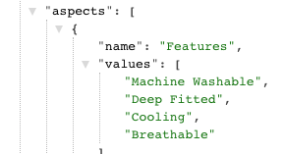
Aspect Sources
Unified Metadata System (UMS)
Unified Metadata System (UMS) provides unified names and values that are applicable in the context of a category (ie, the category spec). UMS acquires data from multiple data sources and serves different data sets including seller tags, buyer tags, catalog, discovery, etc. UMS also supports data translations in Russian, Portuguese and Spanish. (wiki)
DF Namespace
LIME uses the Aspect Keys from UMS to get Aspects Values from the Cassini from using field apsect_${dfAttributeName} - link
MSKU Namespace
ListingField.Aspects
ListingField.MskuTraitNames
ListingField.MskuAspects (git, git2)
Source

Slide 15
Aspect Powered MSKU Algos
Splice
Request
Body
Selected
MSKU Aspects
Category
Service
SPLICE - Recall
Now uses Aspect Importance, MSKU Trait Names, and MSKU Aspects to generate RecallSets
CassiniTitleRecall
HomeSplice
SimilarMskuVariantBlueprints - SimplAMLv9PairwiseWebMskuVariantAspectsSeedMskuPromotion
Based on SimplAMLv9PairwiseWebMskuVariantAspects
Provider
TopNAspectsWithScoreBySeedCategory
Notable Additional Recall
CategoryRecall with Aspect Importance (Code - Jenkins Job)
Filters
SameCatLevel (removed)
SeedMskuPromotionScoreStage
SimplAMLv9PairwiseWebMskuVariantAspectsMskuPromotionAdRateV1
Filters
SeedMskuPromotionScoreWithAdRateSensitivityStage
MSKU Algo
Request
Transformer
UMS Loading
Cache
UMS
Cassini
Title
Recall
UMS
Aspects
Keys
BullsEye
LIME
Request
Top
Importance
Aspects
Top Aspects
Job
(CouchBase)
Aggregate
Recall
CouchBase
Listings
Rank
Enrich
Cassini
Response
Transformer
Filter
& Demotions
TORA

Slide 16

Aspects
and
Ad Rate Boosting
Source

Slide 17
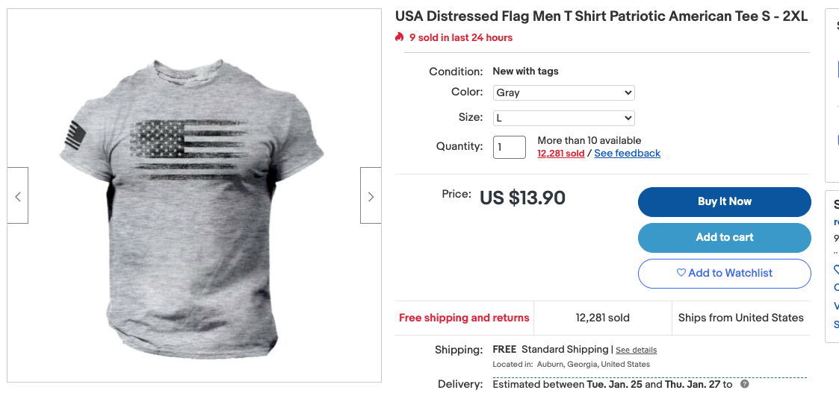
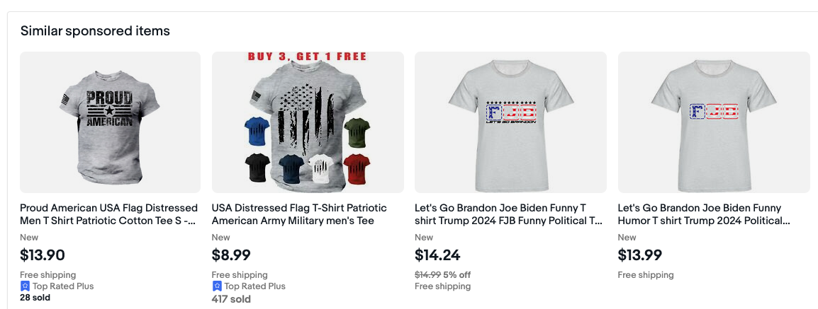
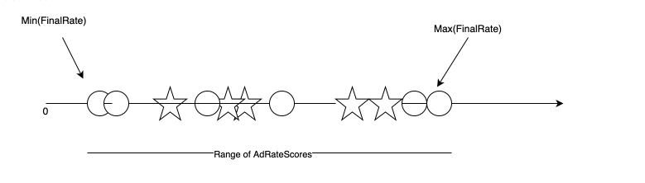
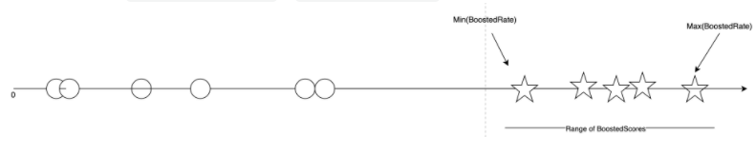
Aspects and Ad Rate Boosting
Using Demotion Stages to Boost Scores
Based on these PRs
SeedMskuPromotionScore (with Top Aspect Importance)
SeedMskuPromotionScoreStageWithAdRateSensitivity (still under test)
Source

Slide 18
Road Map
Complete EP and Launch MSKU Refresh with Demotion and Ad Rate Sensitivity
Develop MSKU ML Ranker v1
ML Aspect Importance by Use Case
Add MSKU to
SOI
ImageSim
DISC
COMP (ask CCOE to do this)
Bank some big bucks for 2022 and beyond

Slide 19
Demo
Q&A
Daniel Masotti
Tim Ding
Rashmi Jayakumar
Vamshi Sama
Xiaoyue Zhang
Vishnu Leelakrishnan
Adam Ilardi
Thanks to the MADSNAP team
Rish Agarwal
Akshay Agarwal
Anas Bouzoubaa
Rick Cui
Prathamesh Jagtap
Mahdi Makki
Daniel Masotti
Mahdi Makki
View Item Page (Zeus) team
Ashima Devan
Jorge Gonzalez
Jiayun “Harry” Li
Ruslan Prytula

Slide 20


Appendix
Links
#homesplice
#homesplice-cassini
MSKU SIM Variants on HomeSplice (Original)
MSKU Relevance PRD Q4 2021
MSKU MLR Brainstorming
HOWTO: Enable MSKU for MFE and HomeSplice
View Item / dWeb - MSKU - refresh ATF merch placements
Cassini for Dummies
HomeSplice Dependencies
go/delirium
Source

